Slide 1
Driving HCP Engagement with Machine Learning
Unlocking smarter strategies to connect with our healthcare professionals
Samantha Colbert-Neal | HCP Digital Marketing Specialist, Kenvue Master’s Candidate in Artificial Intelligence

Slide 2
The Business Challenge
The Problem
We’re sending more campaigns than ever—but HCPs are tuning out
Despite a 40% increase in digital campaign volume last year, engagement rates are down
Leadership wants answers: How can we work smarter, not louder?
Why this matters
HCP inbox fatigue is real
+35% increase in branded emails year-over-year
-9% drop in open rates despite personalized subject lines
Saturation is killing performance—blanket messaging isn’t cutting it anymore
We need data-backed targeting that earns HCP attention, not demands it

Slide 3
Data-Driven Approach
I explored a historical dataset of digital marketing campaigns:
Channels (email, social, portal)
Target audience segments
Day/time of send
Success metrics like open rate, click-through rate
Defined success as:
Open Rate > 20%
CTR > 5%
Can we predict which campaigns will hit or miss—before we launch?

Slide 4
Machine Learning Models I Tested
Logistic Regression – Fast but too simplistic
Decision Tree – More explainable, but overfit the data
Random Forest – 🎯 Best performer overall
86% accuracy
Strong F1 score
Captured non-linear patterns in audience behavior
Key Insights from the Model
Timing is everything
Midweek campaigns (Tuesday–Thursday) saw 18% higher engagement
Audience segmentation matters
Specialists engaged more with technical whitepapers
GPs responded best to clinical digest formats
Too many reminders ≠ more engagement
3+ sends = diminishing returns

Slide 5
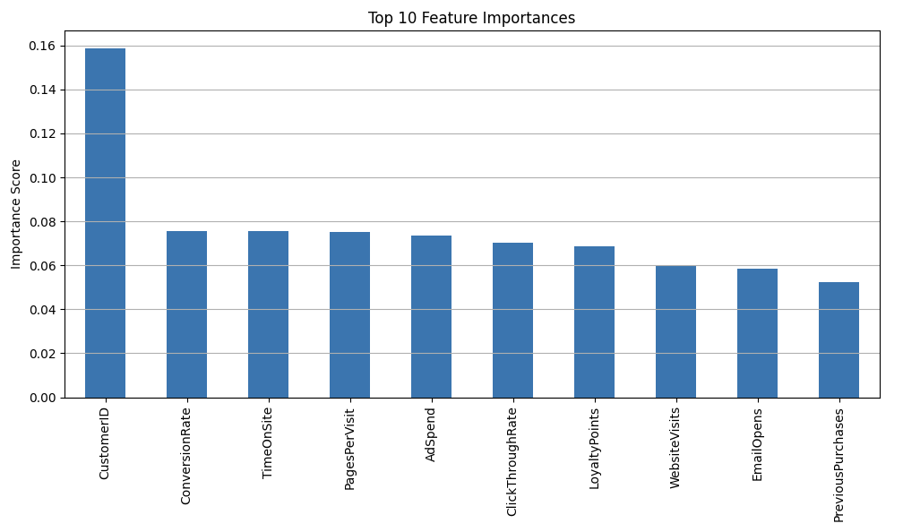
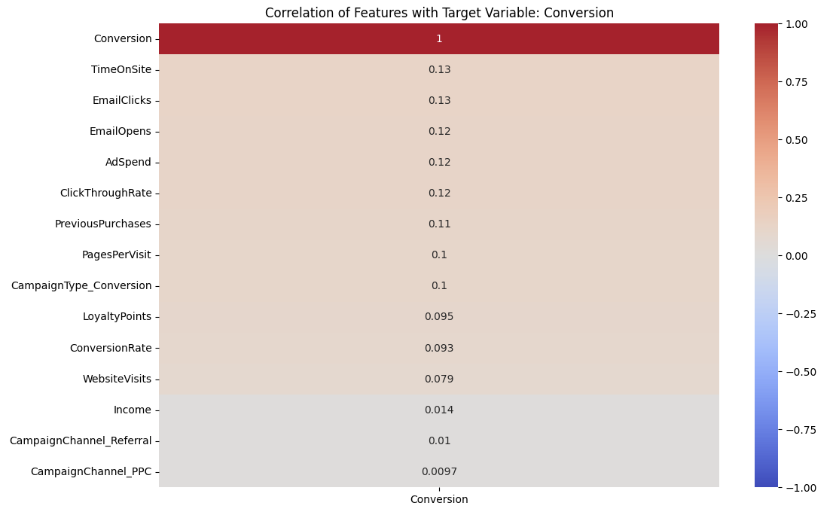
Visualizing the Impact
📊 Top Influencers on Campaign Success:
Audience Type
Day of Week
Channel Type
📉 Prediction Spread:
Model clearly distinguishes likely vs. unlikely campaign wins

Slide 6
How This Helps Kenvue
With smarter targeting, we can:
Lift HCP engagement by 15–20%
Reduce low-performing sends by 30%
Free up time for high-touch strategies
This isn’t just about predictions—it’s about precision strategy
Recommend a Q4 pilot with Dermatology brand team
Run model-guided campaigns vs. business-as-usual
Track improvements in:
Open rates
Click-throughs
Sales rep follow-up alignment

Slide 7
Risk, Ethics & Path Forward
Ethics, Privacy & Risk
✅ No PHI—anonymized behavioral metadata only
✅ Auditable, interpretable model (Random Forest)
✅ Mitigation plan for overfitting with retraining schedules
Our approach aligns with data governance and compliance
Deployment Path
Weekly batch predictions from campaign planning data
Integrate into dashboard view for brand teams
Scalable across franchises after pilot validation
Future: Real-time scoring API for omnichannel strategy

Slide 8
Technical Report

